Slide 1
9:41 AM
100%
9:41 AM
100%
Settings Phone
All Contacts
Edit
Cancel New Message Send
New Message Cancel
Cancel Printer Options
Downloading 20 of 64
8 of 13
Genres
Featured
Charts

Slide 2
Accounts
New
Store
Movies
Edit
All Mailboxes
Inbox
Standard
Standard
Satellite
Delete
i
9
Mail
Select Select All
Select
Select All
Paste

Slide 3
Search
Label:
Label: Default Value
To: joh
John Appleseed
Home jappleseed@apple.com
Value 2 Cell Style
Text Label
Detail text label
Dahlia
This is a dahlia
Daisies
These are daisies

Slide 4
Fri May 31
6
45
Sat Jun 1
7
50
Sun Jun 2
8
55
Today
9
00
AM
Tue Jun 4
10
05
PM
Wed Jun 5
11
10
Thu Jun 6
12
15
Deutsch
English
Espanol
Eesti
Suomi

Slide 5
6
45
7
50
8
55
9
00
AM
10
05
PM
11
10
12
15
6
11
7
12
8
13
From
9
to
14
10
15
11
16
12
17

Slide 6
Turn On Location Services to Allow Maps to Determine Your Location
Settings
Cancel
A Short Title Is Best
Done
Weak Security Code
This code is too simple and can be
easily guessed. Choose a different
code.
OK

Slide 7
Newsstand
Store
Flag
Mark as Unread
Move to Junk
Cancel
Delete Contact
Cancel

Slide 8
0:00
-0:00
AirDrop:
Contacts Only
AirPlay

Slide 9
AirDrop
Share instantly with nearby contacts.
To find other people, ask them to open
Control Center and tap AirDrop.
Message
Mail
Twitter
Flickr
Quick Look
Save to
Camera Roll
Assign to
Contact
Copy
Cancel

Slide 10
Cancel Options
Option Name
Option Name
Option Name
Option Value
Stepper Value
VoiceOver speaks items on the
screen:
∙ Tap once to select an item
∙ Double-Tap to activate the slected
item
∙ Swipe three fingers to scroll
SPEAKING RATE
Print

Slide 11
Audiobooks
Tones
Favorites
Purchased
Downloads
Potential dog names
9:30 AM
To-do list for work
May 30
Band names
May 29
A
A
Wi-Fi ONO6B75

Slide 12
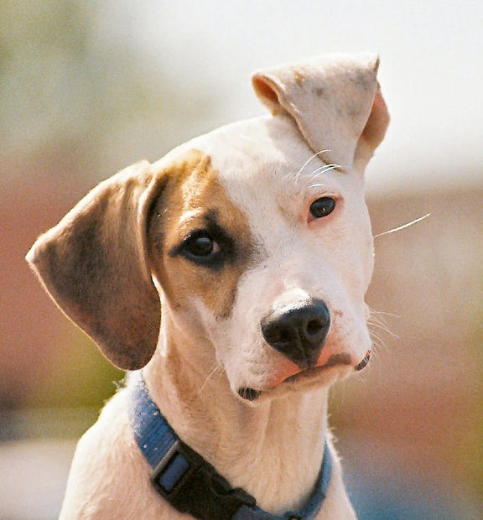
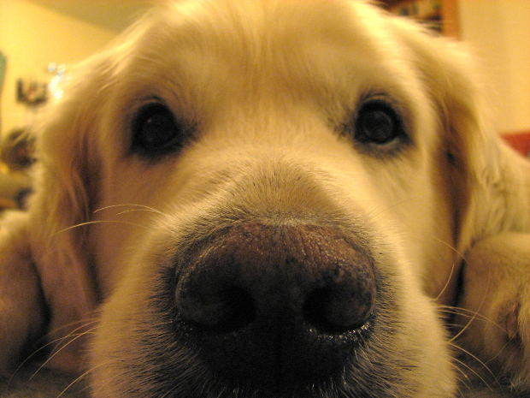
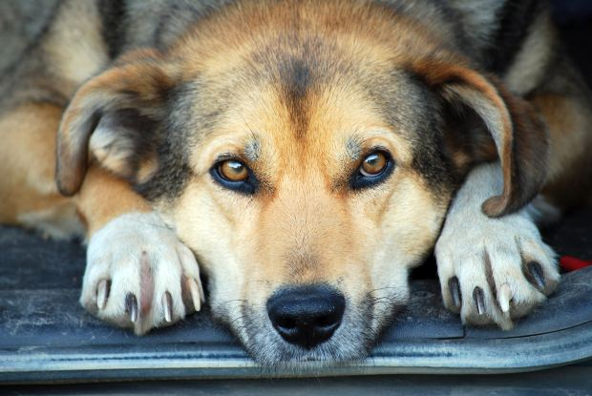
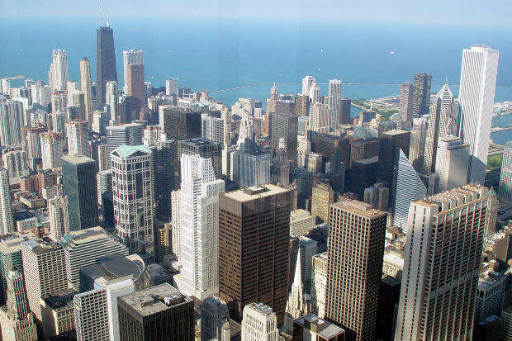
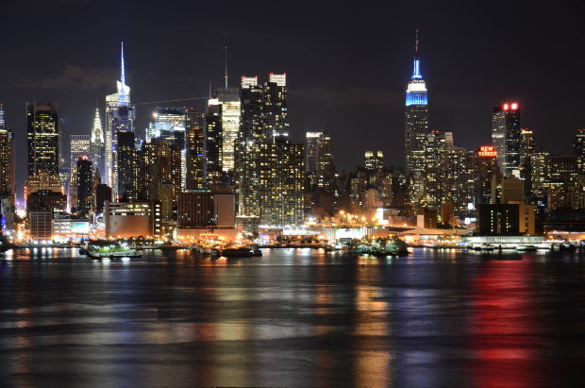
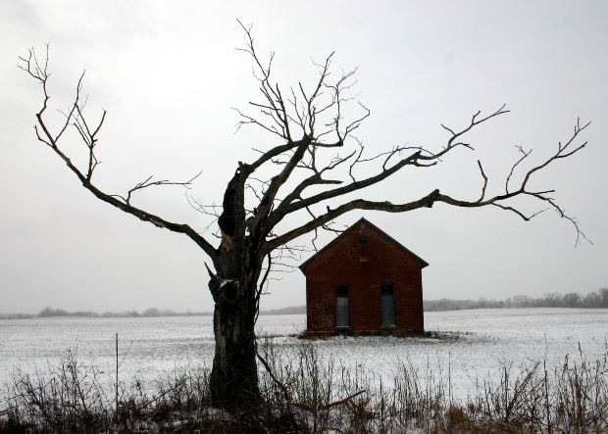
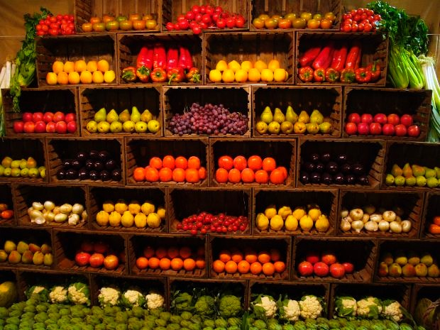
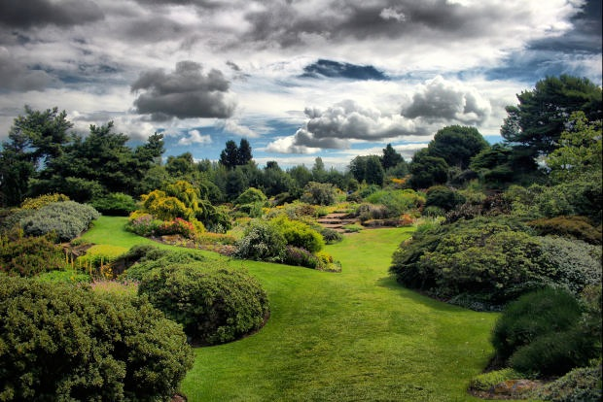
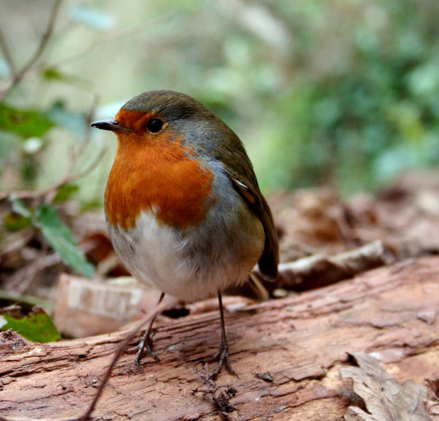
1:06
-5:03
Get Lucky (feat. Pharrell Willia
Daft Punk - Random Access Memories
Repeat
Create
Shuffle
PHOTOS
Camera Roll
352
My Photo Stream
5
Panoramas
12

Slide 13
All Contacts
Search
F
A
Rachael Falworth
B
C
D
Jose Fargo
E
F
G
Jim Ferris
H
I
J
Kimmie Fong
K
L
M
Lynn Foote
N
O
P
Q
G
R
Pete Gardner
S
T
U
Monique Gaspard
V
W
X
Y
Noah Greggory
Z
#
Tom Greene

Slide 14
Settings Maps
Distances
In Miles
In Kilometers
CALLS
Reply with Message
Call Forwarding
Call Waiting
Show My Caller ID
Blocked
Change Voicemail Password

Slide 15
9:41 AM
100%
Inbox (11)
10 of 58
Maria G
To: Maria G more...
Out of the office next week
May 31, 2013 at 8:50 AM
Well, I’m finally going to Italy. Can you believe
it? It’s been a dream of mine since high school.
Sent from my iPad
Mailboxes Edit
Inbox 9
VIP

Slide 16
New Message Cancel
To: John Appleseed
Subject
Dinner tonight?
Send
Q
W
E
R
T
Y
U
I
O
P
A
S
D
F
G
H
J
K
L
Z
X
C
V
B
N
M
.?123
space
return

Slide 17
9:41 AM
100%
Edit List Done
List Item
List Item
List Item
TO
List Item
CC
List Item
List Item
List Item
List Item
Add List Item
ACCOUNTS
Updated Just Now

Slide 18
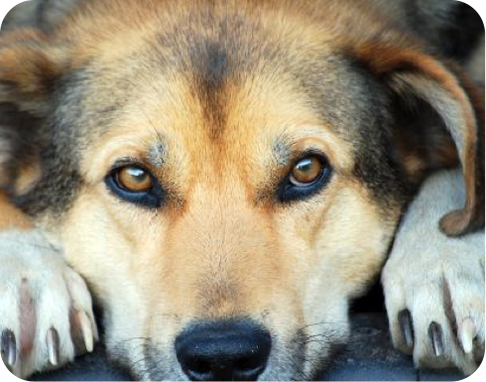
9:41 AM
100%
Messages
Erica Haims
Contact
Definitely.
In fact, you might recognize one of them.
Who is it?
Remember Tasha? She lived on our floor freshman year.
No way!
Way. And we were just talking about you.
iMessage
Send

Slide 19
9:41 AM
100%
1
2
ABC
3
ABC
4
GHI
5
JKL
6
MNO
7
PQRS
8
TUV
9
WXYZ
*
0
+
#
Call
Favorites
Recents
Contacts
Keypad
Voicemail

Slide 20
New List
Surprise Party
10 items
Payments Due
3 items
Groceries
7 items
Alumni Week
17 items
Beach Party
6 items
Find snorkel gear
Wax board
Buy sunblock
Pick up Tiffany
5th and Mission

Slide 21
Card label
7 items
Card label
7 items
Card label
7 items
Card label
7 items
Card label
7 items
Card label
7 items
Card label
7 items
Card label
7 items

Slide 22
9:41 AM
100%
2013
S
M
T
W
T
F
S
MAY
1
2
3
4
5
6
7
8
9
10
11
12
13
14
15
16
17
18
19
20
21
22
23
24
25
26
27
28
29
30
31
JUNE
1
Today
Calendars
Inbox (3)

Slide 23
9:41 AM
100%
June
S
M
T
W
T
F
S
9
10
11
12
13
14
15
Monday June 10, 2013
8
Call with Barry
9
9:41AM
10
Grattan St. Presentation
Studio K
11
Team Lunch
Noon
1
Debriefing
Room 47
2
Weekly Staff Meeting
3
Today
Calendars
Inbox (3)

Slide 24
9:41 AM
100%
today
all
missed
Messages
Paul Zemanek 21m ago
Definitely.
Paul Zemanek 21m ago
In fact, you might recognize one of
them.
Calendar
Review Script with Sebastian
Invitation from Sebastian Bauer
Today, 3:00 PM
Game Center
Game Center 24m ago
dbecker3 (Dave Becker) has accepted your friend request.
Game Center 2h ago

Slide 25

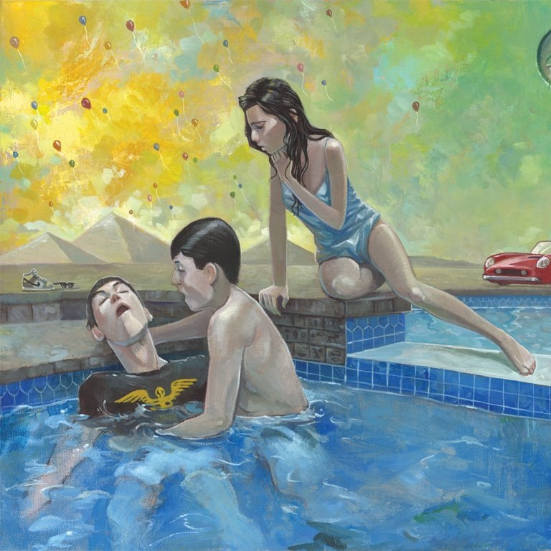
A u t o
V I D E O
P H O T O
S Q U A R E

Slide 26
Sign in with your
Apple ID
Use your Apple ID to play games with
your friends, wherever they are.
Apple ID
example@icloud.com
Password
required
Forgot your Apple ID or password?
Want a different ID for Game Center?

Slide 27

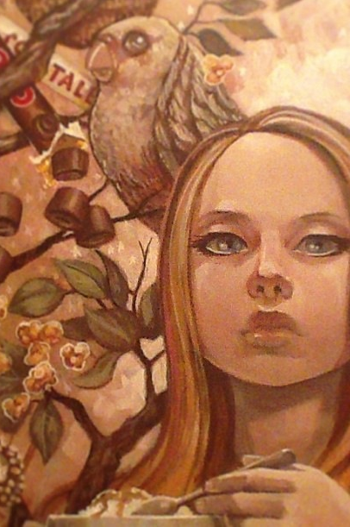
Collections Moments Select
June 4, 2013
Share
Wallpaper Choose
Dynamic
Stills
Photos
Photo Stream
Albums

Slide 28

9:41 AM
100%
Store
Movies
Edit
Image
placeholder
Movies
TV Shows
Music Videos

Slide 29
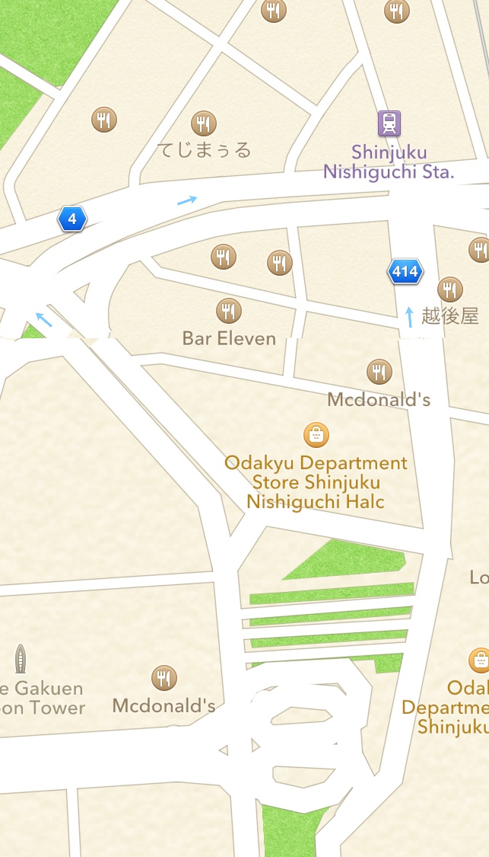
9:41 AM
100%
Search
Keynotopia
3D
i

Slide 30
9:41 AM
100%
Categories
Featured
APP
COLLECTIONS
New & Noteworthy
See All
App Name
Category
PRICE
App Name
Category
PRICE
App Name
Category
PRICE
App Name
Category
PRICE
What’s Hot
See All
App Name
Category
PRICE
App Name
Category
PRICE
App Name
Category
PRICE
App Name
Category
PRICE
Featured
Top Charts
Near Me
Search
Updates

Slide 31
No Service
4:00 PM
Search
All
Diagnostics
Fitness
Lab Results
Medication
Nutrition
Sleep
Vital Signs
Me
Dashboard
My Health
Medical ID
Sources

Slide 32
No Service
4:00 PM
Medical ID
Medical ID
A Medical ID provides medical information about you that may be important in an emergency, like allergies and medical conditions.
The Medical ID can be accessed from the emergency dialer without unlocking your phone.
Create Medical ID
Dashboard
My Health
Medical ID
Sources

Slide 33
AT&T
1:18 PM
100%
Messages (1)
Dom
Details
Hello
Hello
H
Hi
Delivered
Hi
0:01
Yes
Ok
No
Q
W
E
R
T
Y
U
I
O
P
A
S
D
F
G
H
J
K
L
Z
X
C
V
B
N
M
.?123
space
return

Slide 34

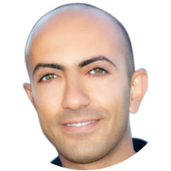
Recents
OL
BL
PM
U
Amir
Oliver
Blank
Paul
Uma
Facebook

Slide 35
AT&T
1:18
Monday, June 2
Mark as Read
Reply

Slide 36
AT&T
3:41 AM
85%
Today
Notifications
SBUX
73.85
+ 0.61
NKE
76.72
- 0.19
YHOO
34.87
+ 0.22
Tomorrow
You have no events scheduled for
tomorrow.
Edit
Weather information provided by
The Weather Channel, LLC.
Stock information provided by YAHOO!

Slide 37
now
You mean my birthday?
LOL
Send
“LOL”
LOLA
Q
W
E
R
T
Y
U
I
O
P
A
S
D
F
G
H
J
K
L
Z
X
C
V
B
N
M
.?123
space
return

